Slide 1
ACQUIRE AND REFERENCE DATA
Informatics

Slide 2
Lesson Objectives
Open and Closed Questions
Interviews
Observing
Surveys and Questionnaires
Database Queries
Application Program Interfaces (APIs)
Referencing Sources

Slide 3
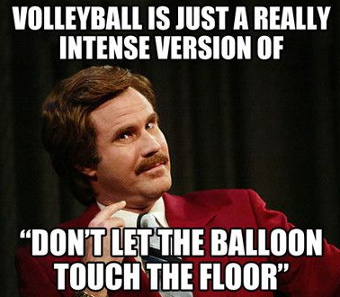
Open and Closed Questions
CLOSED Questions only allow a limited number of responses, and are often found on Exams and Surveys. True/False, Multiple Choice, calculated number value etc. OPEN Questions do not limit or restrict the responses that can be made. These are used a lot in Interviews, “Short Answer Questions”, and Creative Essays.
True or False?

Slide 4
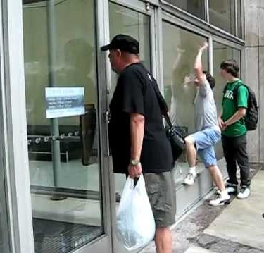
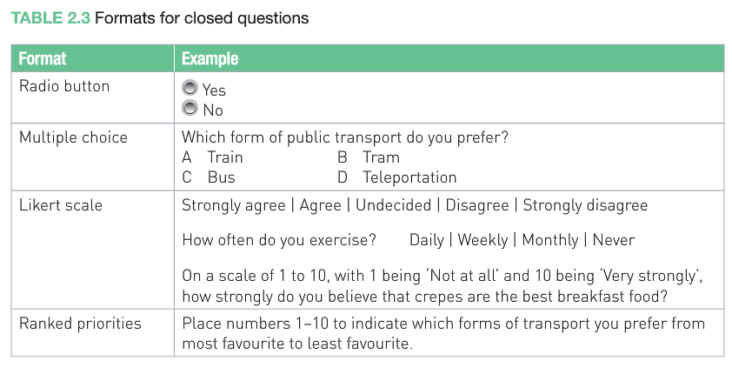
Closed Questions
Not a lot can happen on responses to closed Questions. This makes them easier to process.

Slide 5
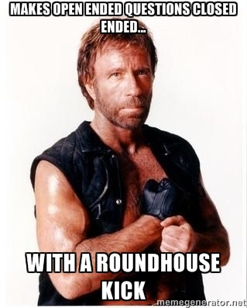
Closed Questions
Closed Questions – Limiting the choice of responses should also prevent your respondents from giving detailed answers and also make it quicker and easier for them to respond. So Closed Questions make it easier for both the Survey Participants and for the person examining the results.

Slide 6
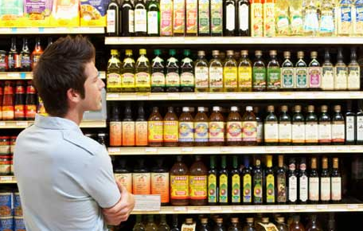
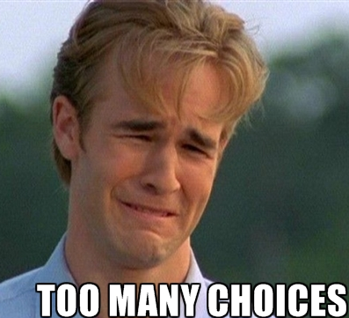
Closed Questions
Usual Formats for closed questions
Radio Button – Yes / No
Multiple Choice (3, 4 or 5 options)
Likert Scale – strongly agree / agree / undecided / disagree / strongly disagree
Ranked Priorities – Place a number between 1 and 10 next to each item

Slide 7
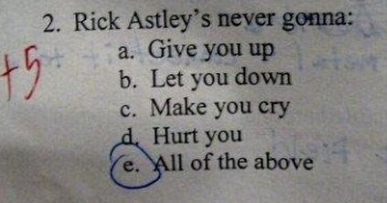
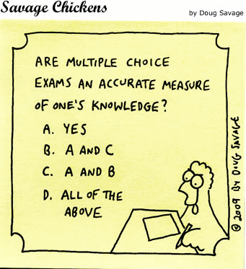
Closed Questions
Closed Questions
Limit the responses on which the attitudes and beliefs are measured. These are usually: -
Yes / No
Check Boxes (Tick Boxes)
Multiple Choice
Generally considered to be QUANTITATIVE in nature as these answers can be easily converted into numbers (eg. How many People chose each of the answers, and we can then graph this).
Closed Questions are easier to develop, quicker to administer and answer and easier to collate and analyse.

Slide 8
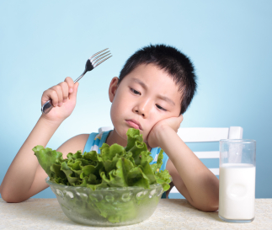
Closed Questions
Limiting responses too much on Closed Questions can introduce bias. How often do you eat salad ? Frequently, Sometimes, Rarely
By leaving out “Never” as an option, it can be suggested that all people eat salad from time to time, and therefore everybody is following a healthy diet.

Slide 9
Open Questions
Open Questions have no restrictions imposed on the answers. (A lot more possibilities can come out in the answers) These type of questions are asked in Job Interviews, in conversations with friends, and on Talk Shows on TV. “What have you done that you are most proud of, and did you have to work very hard to make it happen?”
Responses from a significant number of people to a given Open Question are needed, to be able to identify any patterns or trends. We also assign codes and priorities to common responses that can then be statistically analysed. Eg. Word counts of commonly used words or phrases. Prioritise these common items, and analyse them.

Slide 10
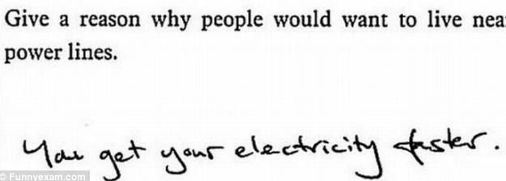
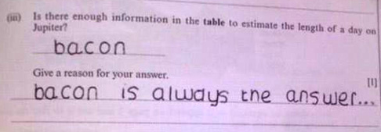
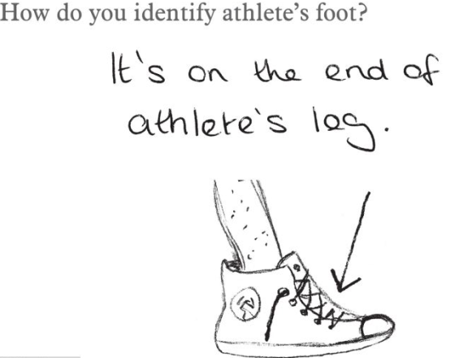
Open Questions
Open Questions
Don’t limit the answers of the respondent.
Should be written so that respondent is capable of correct interpretation
The wording of these questions must try to limit the scope of possible answers, and often also allow for follow up questions
They are QUALITATIVE in nature because answers are measured and considered by feel.

Slide 11
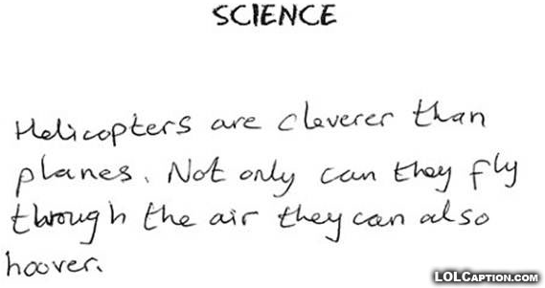
Open Questions
Open Questions usually have no single correct answer. You are asking your respondents their belief / opinion on a particular topic.
Answers to this form of questions can and should be lengthy and unique.

Slide 12
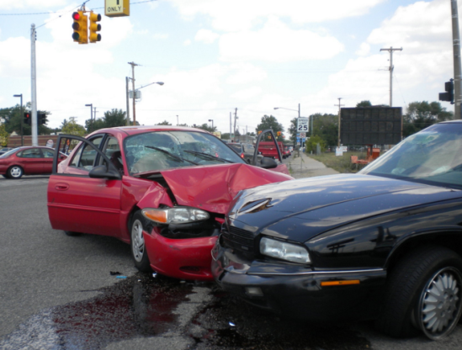
Faulty (or Dodgy) Questions
Some questions have faults in them which create slanted or Biased results. A Loaded Question contains controversial or unjustified assumptions. The question is loaded up already with part of the answer. Eg. What happened when the red car slammed into the black car ? The question is loaded because it assumes and implies that the red car was speeding and caused the accident.

Slide 13
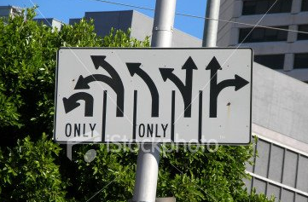
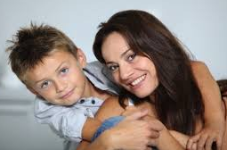
Faulty Questions
People asking these questions usually have a “Hidden Agenda” where they are trying to get only certain specific answers that support their case. A Leading Question directs respondents to limited options, or to forced decisions where one response has to be better than the other. Eg. Do you think Drug Dealers should get life in prison or the death penalty? This question leaves no room for any answers other than Prison or Execution. Eg. Do you think Mothers or Fathers make better single parents? This implies that one must be better than the other. DO NOT USE LOADED OR LEADING QUESTIONS IN YOUR SAT

Slide 14
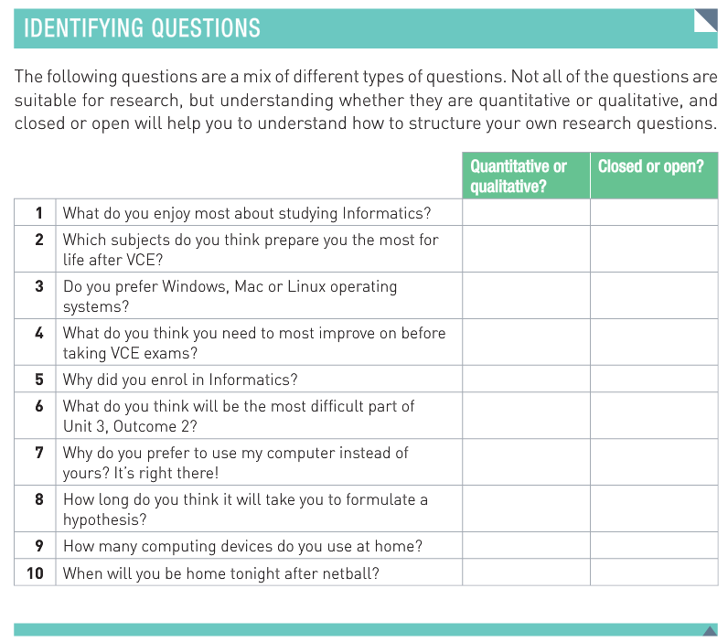
Classwork (5 mins) – Page 96 in Textbook
@@ text

Slide 15
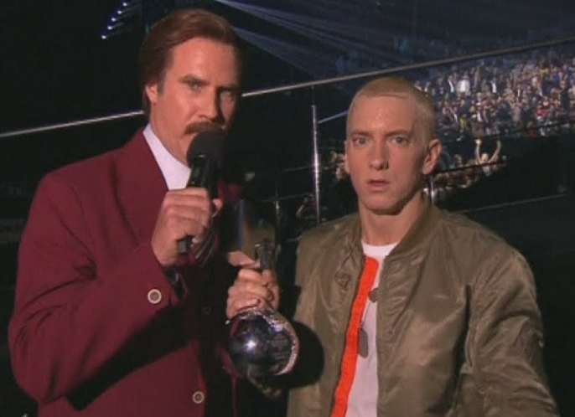
INTERVIEWS
Interviews are real time, and unlike Surveys the interview can be shaped by the responses you are getting. You realise that some lines of conversation are not worthy of pursuing further, but other times more questions can be asked to get additional details about certain areas of interest. Interviews are best conducted face to face so that we can read the body language associated with each response, not just hear the words. Eg. We can see when the person is interested and excited about something, or whether they are disinterested. The next best thing to a live interview is using Skype or Google Hangouts, to conduct a video interview.

Slide 16
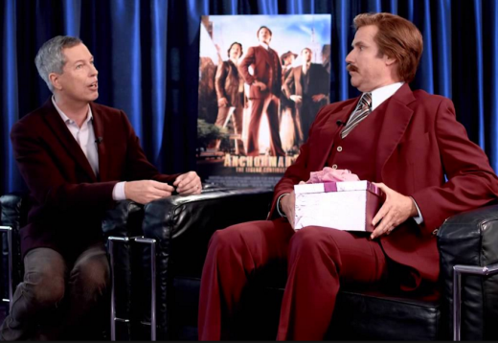
Interviewing Tips and Techniques
Introduce yourself, clarify purpose of interview and how information will be used.
Start with simple questions to put everyone at ease and establish flow
Have a list of questions
Be aware of Privacy Laws and do not get too personal
Have a pre-prepared list of questions and have it with you
Avoid getting side-tracked off topic
Give people time to think, and do not interrupt
End interview by asking if there is anything else they would like to add?
Get prior permission to record the interview (for future reference and to avoid the burden and distraction of making notes.
If you can manage it, Video recording would be great to have to be able to put edited snippets into the U401 Multimedia Presentation website.

Slide 17
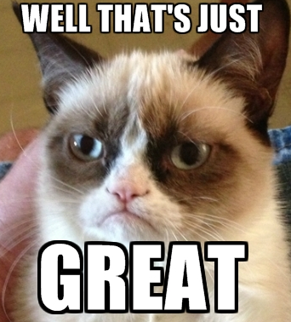
Interviews - Summary
Interviews - slow, expensive, and they take people away from their regular jobs and duties, but they allow in-depth questioning and follow-up questions.
They also show non-verbal communication such as face-pulling, fidgeting, shrugging, hand gestures, sarcastic expressions that add further meaning to spoken words. e.g. "I think it's GREAT" could mean vastly different things depending on whether the person was sneering at the time!
A problem with interviews is that people might say what they think the interviewer wants to hear; they might avoid being honestly critical in case their jobs or reputation might suffer. Or they might be too embarrassed to say what they really think.

Slide 18
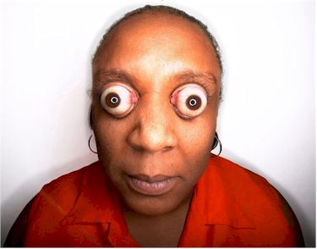
OBSERVING (See Pages 98-99)
Observing can be “overt” with people knowing they are being watched, or “covert” using hidden cameras but this may be unethical or illegal. For your SAT you will probably be doing things like observing sports games, or what type of people are getting fast food, what items people are buying in a shop, what type of devices people are using, what they are wearing etc, etc but probably not videoing without permission. Make sure you make notes, record statistics at sports matches, or make video or audio recordings, as memory is not reliable.
Observation and Interviews are time consuming and a lot of work, so you will probably need to do these sparingly. As well as Interview(s), also do Surveys, and gathering data from the Internet for the SAT.

Slide 19
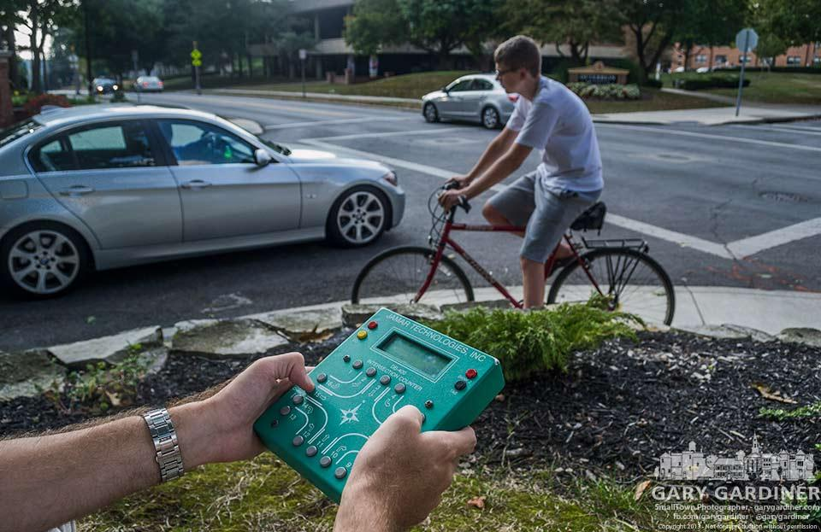
SURVEYS
Direct Observation - lets you focus on details of importance to you; lets you see a system in real rather than theoretical use (often faults are unlikely or trivial in theory but quite real and annoying in practice)
Surveys - written surveys let you collect considerable quantities of detailed data. You have to either trust the honesty of the people surveyed or build in self-verifying questions (e.g. questions 9 and 24 ask basically the same thing, but using different words - different answers may indicate the surveyed person is being inconsistent, dishonest or inattentive).

Slide 20
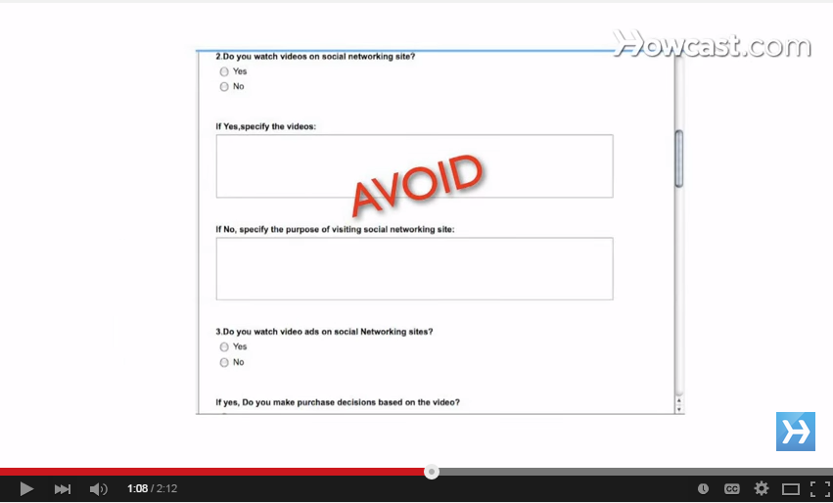
How to Make a Good Survey (2 min Video)
https://www.youtube.com/watch?v=SsZySkZ8bRo
Also See Pages 100 to 103 of Textbook

Slide 21
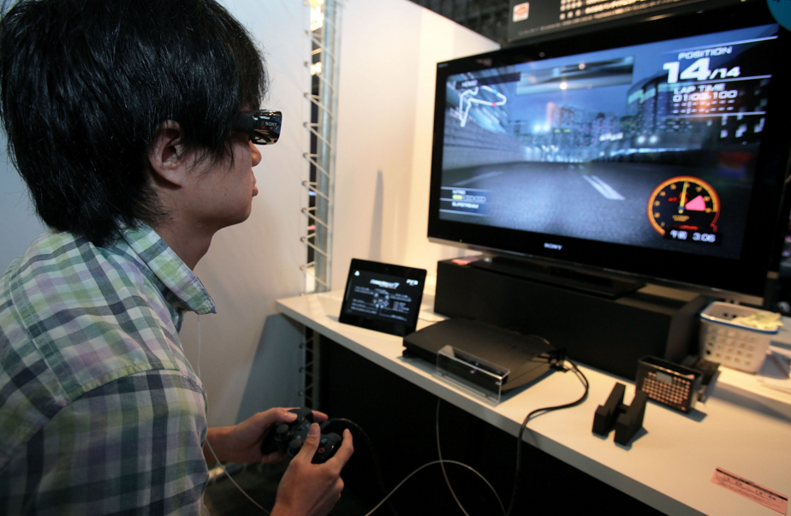
SURVEYS – Representative Samples
If we do an “Effects of Computer Gaming” survey with a group of 15 year old boys who all play games, then this is not a Representative Sample ! We need to ensure our surveyed group also includes females, adults, children, and non gamers. Then we get a result that is representative of the general population. See page 104 in textbook for more examples

Slide 22
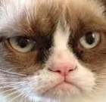
Surveys – Pros and Cons
Advantages |  | Disadvantages
Can be done Online with Survey Monkey (10 Questions for free) or Google Docs. |  | Respondents cannot ask anything if they are unsure or want to say something extra
Quick and Easy to Collect when done Online. |  | Respondents may not bother completing all of the questions
Can analyse responses with Spreadsheets and easily make Stats, Graphs and Charts. |  | People may misinterpret questions or not understand them.
Can also put spreadsheet data into free online Infographics makers like infogram, easelly, etc. (Useful for U401 Presentation) |  | Because Surveys are always optional, Bias might be introduced because only people interested in the topic will be bother to do the survey.
Easy to compare responses because everybody is asked the exact same questions |  | People might be reluctant to give truthful answers on questions they find embarassing.
See page 100 for full lists

Slide 23
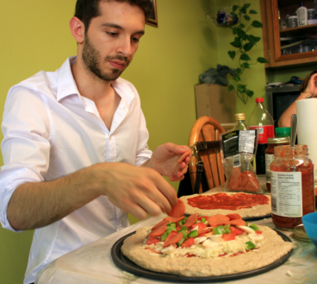
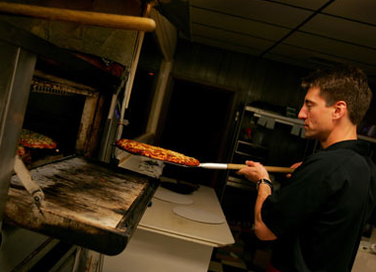
DATABASE QUERIES
There are three main ways of Querying a Database: (Query means get a set of specific data) (Like getting a particular set of Pizza Toppings) Query By Example: QBE
Structured Query Language: SQL
Application Programming Interface: API

Slide 24
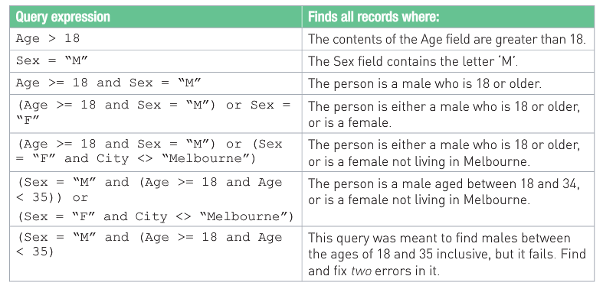
Database – QUERY BY EXAMPLE
These are like the Queries we did in MS-Access for the U301 SAC.

Slide 25
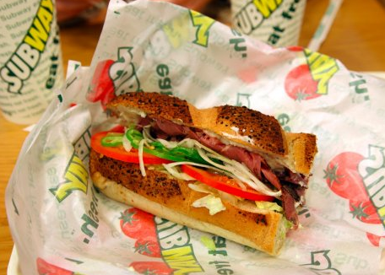
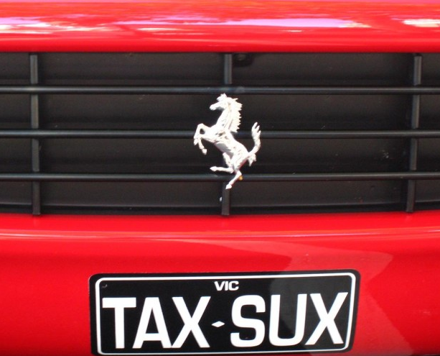
Database SQL
This type of Query requires you to specify fully and exactly what you want.
Select CARS.Make, CARS.Model, CARS.Rego
FROM CARS
WHERE (CARS.State = “VIC”) would give a list of all Cars in our Car Club with Victorian Licence Plates.

Slide 26
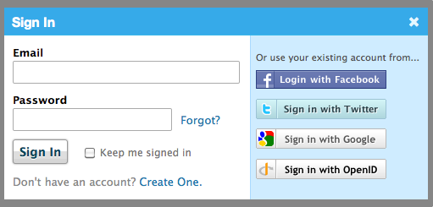
API Database Queries
Large Online Data Systems share database data such as user logins and passwords, and embedded videos.
Eg. When you log into an App using your FB logon, the App is able to “talk to” or “Interface” with Facebook and check that you are a valid FB user. The FB Users Database on the FB Authentication Server is queried behind the scenes during this process. More complicated APIs do things like build the FB embed code and pass it to FB so that your Vimeo video for example can be shared into a special FB compatible player on your FB Page.

Slide 27
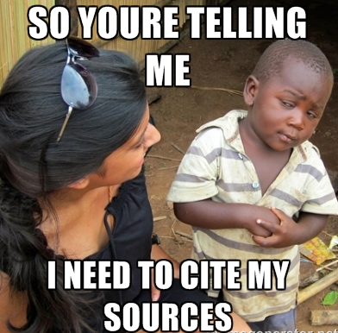
Referencing Sources
Pages 107 to 111 in the Textbook shows four methods for referencing our work:
Harvard
APA (American Psychological Association)
Chicago
IEEE (Institute of Electrical and Electronic Engineers)
At school, you have probably used Harvard method in your other subjects, and so you might want to mostly use this one for your SAT. APA is another method widely used by students for providing citations (references) on their assignments.

Slide 28
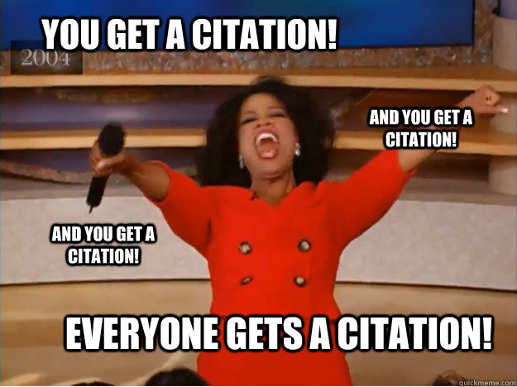
Harvard Bibliography
Using the Harvard Referencing System – Australian Version a bibliography should follow the following: -
Written in alphabetical order citation – ignore ‘the’, ‘a’, and ‘an’ at the start
Double line spaced between entries
Written on a separate sheet of paper with the heading Bibliography
The last page of your assignment
In-text citations should agree with the Bibliography

Slide 29
In-text References (Quotes)
There are two types of in-text references (Quotes)
Direct quotes – written within single quotation marks – the exact words of the author, show the author, date, page details; use sparingly, words are not included in word count.
Indirect quotes- using the author‟s ideas, not the exact words, show author, date page details; preferred option, words count in word limit if you are writing an essay with a limit.

Slide 30
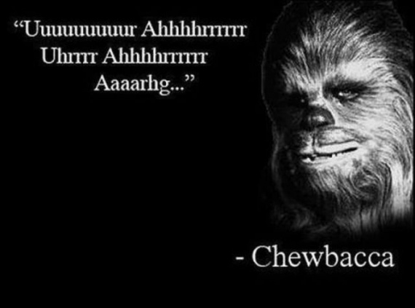
In-text References (Quotes)
Always refer to the author of the quote either by:
Author integrated into the main sentence: Ferrari J (2007 p. 13) warns “Teachers are beginning to find they are being expected to provide…”.
Author not integrated into the main sentence: Teachers are increasingly required to… (Ferrari 2007, p.13).

Slide 31
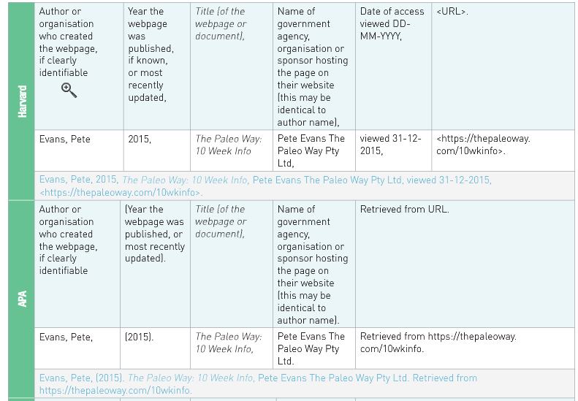
Referencing Websites – Page 110

Slide 32
Referencing our Primary Sources (Eg. INTERVIEWS)
Just like any other reference, primary sources need to be cited too.
Once the interview and analysis has been completed by producing written results, this information becomes secondary sources.
Quotes from the interviewee can be cited in the same way you would cite a book or newspaper article.
When using an interview, the following needs to be attached to allow for any follow up: -
Name of Interviewee
Date and Place of Interview
Contact information of Interviewee
How the interview was conducted
Your name and contact details.

Slide 33
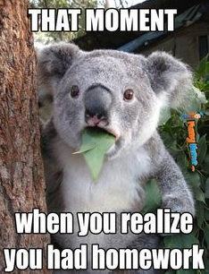
Classwork / Homework
Read fully through pages 94 to 111 of the Textbook
Learn the Essential Glossary Terms on page 124
TYK Questions 9 to 16 test your knowledge on page 126

