Slide 1
Year 11 Computing
UNIT 1: AOS101: Data and graphic solutions

Slide 2
Unit 1 Outcome 1:
On completion of this unit the student should be able to acquire, secure and interpret data, and design and develop a graphic solution that communicates the findings of an investigation

Slide 3
Chapter 1: Data Analysis_Weeks 1&2
Understanding research – Theories and Hypothesis – kk1 (p.3)
Types of research – Quantitative and Qualitative – kk1 (pp.3-4)
Data and Information – kk2 (p.4)
Gathering Data – Sources: Primary and Secondary – kk2 (p.5)
Data Collection Methods – kk2 (pp. 7-9)
Quality of data and information – kk3 (pp. 9 – 11)
Referencing primary sources (pp.11-14)
Seeking Permission – kk4 (pp.15-18)
Privacy – kk5 (p.19)

Slide 4
Chapter 1&2: Data Analysis_Weeks 3&4
Physical Security Controls – kk6 (pp.20-22)
Australian Privacy Principles – kk7 (pp.22-24)
Ethical Dilemmas – kk8 (pp.24-25)
CHAPTER 2: PSM DESIGN STAGE:
Problem Solving Methodology - Overview
Design Tools – kk10 (pp.66-68)
PSM DEVELOPMENT STAGE:
Purpose of Graphic solutions & Types – kk9 (pp.42-51)
Design Principles – kk10 (pp.52-56)
Formats and Conventions – kk11 (pp.56-65)
Softwares and Techniques for Developing graphic solutions and Validation - kk12 (Pp.70-73)
Techniques for testing graphic solutions – kk13 (pp.68-70)

Slide 5
KK1: Understanding research – Theories and Hypothesis
https://www.youtube.com/watch?v=lqk3TKuGNBA

Slide 6
Think, Pair and Share…
What are the different information you see in the following infographics?

Slide 7
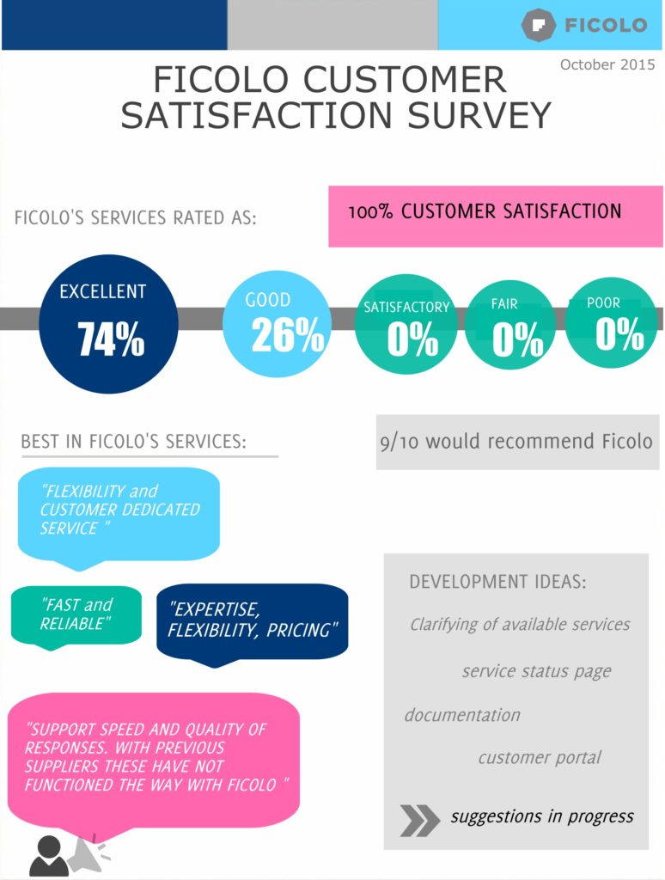

Slide 8
KK1: Types of research – Quantitative and Qualitative
Quantitative data is designed to collect cold, hard facts. Numbers. Quantitative data is structured and statistical. It provides support when you need to draw general conclusions from your research. (something that you can count, measure or categorise and analyse with graphs)
Qualitative data collects information that seeks to describe a topic more than measure it. Think of impressions, opinions, and views. A qualitative survey is less structured: It seeks to delve deep into the topic at hand to gain information about people’s motivations, thinking, and attitudes. While this brings depth of understanding to your research questions, it also makes the results harder to analyze.

Slide 9
Quantatitive Analysis | Qualitative
Quantitative data can help you see the big picture. Validating your hypotheses: Quantitative research will get you numbers that you can apply statistical analysis to in order to validate your hypotheses. Was that problem real or just someone’s perception? The hard facts obtained will enable you to make decisions based on objective observations. Finding general answers: Quantitative research usually has more respondents than qualitative research because it is easier to conduct a multiple-choice survey than a series of interviews or focus groups. Therefore it can help you definitely answer broad questions like: Do people prefer you to your competitors? Which of your company’s services are most important? What ad is most appealing? | Qualitative data adds the details and can also give a human voice to your survey results. Formulating hypotheses: Qualitative research helps you gather detailed information on a topic. You can use it to initiate your research by discovering the problems or opportunities people are thinking about. Those ideas can become hypotheses to be proven through quantitative research. Incorporating the human element: Qualitative research can also help in the final stages of your project. The quotes you obtained from open-ended questions can put a human voice to the objective numbers and trends in your results. Many times it helps to hear your customers describe your company in their own words to uncover your blind spots. Qualitative data will get you that.

Slide 10
Closed Ended Questions | Open Ended Questions
A closed-ended question is made up of pre-populated answer choices for the respondent to choose from Closed-ended questions come in a multitude of forms, including: multiple choice, drop down, checkboxes, and ranking questions. Each question type doesn’t allow the respondent to provide unique or unanticipated answers, but rather, choose from a list of pre-selected options. | an open-ended question asks the respondent to provide feedback in their own words. Open-ended questions are exploratory in nature, and offer the researchers rich, qualitative data. In essence, they provide the researcher with an opportunity to gain insight on all the opinions on a topic they are not familiar with. However, being qualitative in nature makes these types of questions lack the statistical significance needed for conclusive research.

Slide 11
KK2: Data and Information
Data | Information
raw facts no context or meaning Just numbers, characters, symbols, images etc., Examples: Yes, Yes, No, Yes, No, Yes, No, Yes 42, 63, 96, 74, 56, 86 111192, 111234 None of the above data sets have any meaning until they are given a CONTEXT and PROCESSED into a useable form | data with context processed data value-added to data summarized organized Analyzed For example: What does the number 29061996 mean? - data Is it: A birthday? (29th June 1996) - information A bank account number? - information A club membership number? - information A telephone number? – information Without processing or more information this data is meaningless.

Slide 12
Data vs. Information
Data
6.34
6.45
6.39
6.62
6.57
6.64
6.71
6.82
7.12
7.06
Information

Slide 13
Data → Information
Data
Summarizing the data
Averaging the data
Selecting part of the data
Graphing the data
Adding context
Adding value
Information

Slide 14
Data Processing
Typically processing helps transform data into information.
Input
Output
Processing
Raw Data
Information

Slide 15
Processing
Summarizing
Computing Averages
Graphing
Creating Charts
Visualizing Data

Slide 16
DATA | INFORMATION
Data is collection of raw facts and figures. | Information is processed data.
Data is unarranged and unorganized.. | Information is arranged and organized..
Data is un-meaningful. | Information is meaningful.
Data is input. | Information is out put.
Data is used less frequently. | Information is used frequently.
Data represents facts before processing. | Information represents results (obtained after processing).
Data is not helpful in decision-making. | Information is helpful in decision-making.
Data is raw material for information. | Information is the final product of data.
Data are unprocessed records | Information contains processed records
Data is in large amounts | Information is in small amounts
If data is lost, it is very difficult (or even impossible in some situations) to re collect. | If information is lost, it is easily derived from stored data, again.
Data is the asset of an organization and is not available for sale to public. | Normally, information is available for sale to general public.
Data depends upon the sources for collecting data, the collection methods adopted and the people who will collect data. | Information depends upon data.
https://forfreeeducation.blogspot.com.au/2011/08/differences-between-data-and.html

Slide 17
QUESTION
We use ______________________ as input to produce _____________________ which is the output.
Choose between data or information
30,52,68,25,36,24 ________________.
Stop signal from a traffic light________________.
☺♣♠•◘☻♥♦ ___________________.
A yellow card in a football match_____________.

Slide 18
KK2: Gathering Data – Sources: Primary and Secondary
Data Sources
Primary
Secondary

Slide 19
Primary Data | Secondary Data
Data never gathered before Example: Your own questionnaire Advantages: Find data you need to suit your purpose Data interpretation is better Decency of data Propriety issues Greater control Addresses specific research issues Disadvantages: High cost Time consuming More number of resources is needed | Data gathered by another source that has been collected for another purpose Advantages: It involves less time, cost and effort Disadvantages: Quality of research Not specific to researcher’s needs Incomplete information Not timely

Slide 20
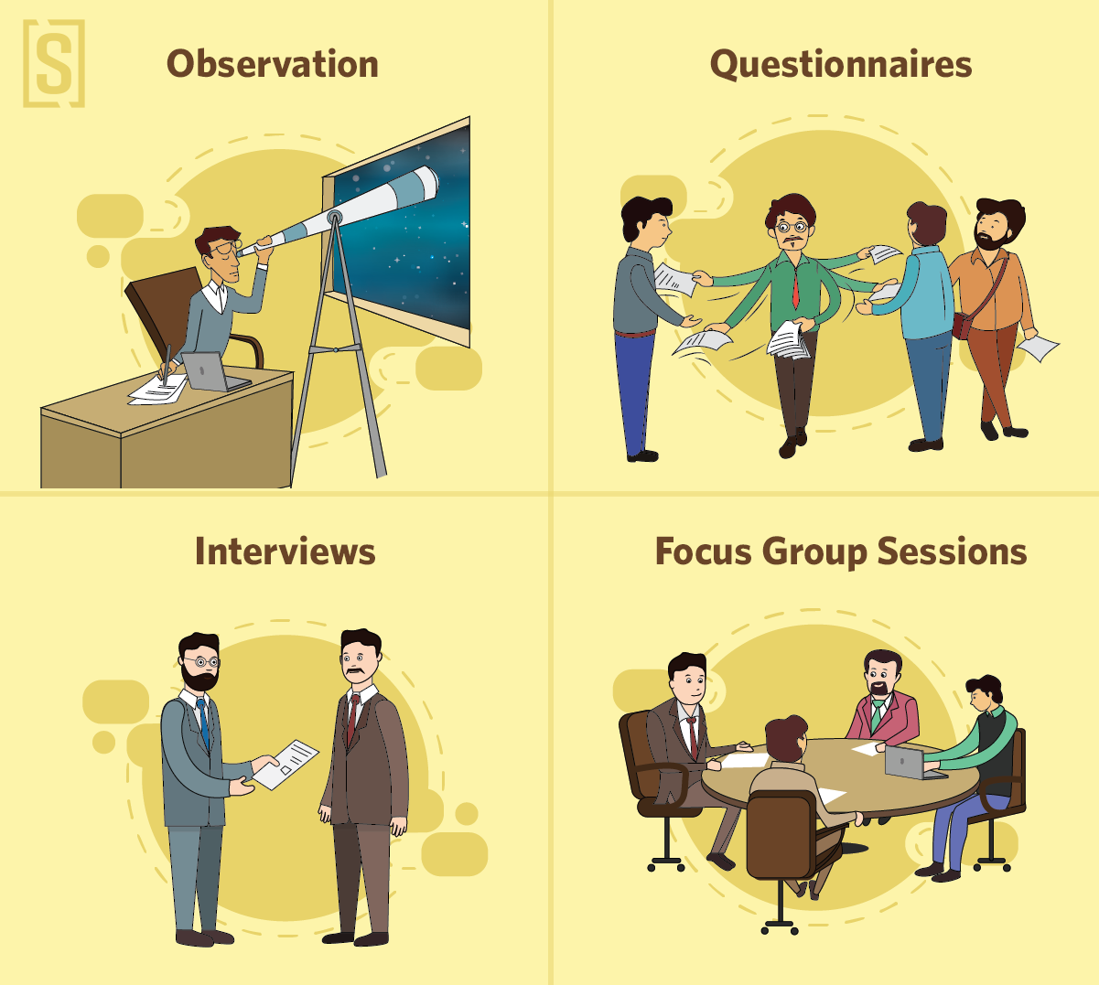

Slide 21
KK2: Data Collection Methods and Techniques (Primary research)
Method (What you use to collect data) | Technique (different ways of collection for that method) | Examples
Survey or Questionnaire (used mainly for quantitative data) | on site, telephone, mail, email, fax, computer | Opinion survey, Market research
Interview (usually qualitative in nature) | Face-to-face, phone, online | Interview with a smoker to understand the motivation behind the habit
Observation (for both qualitative and quantitative) | Face-to-face | Classroom observations of teacher-student interactions or student group work dynamics
Focus groups | On site, computer | To research about a new product or feature update
Experiment (controlled variables and respondent groups) | On site | To study the effect of smoking on causing cancer

Slide 22
Primary research
Quantitative data
Qualitative data
Focus groups
Individual depth interviews
Human observation
Case studies
Surveys
Experiments
Observation
Simulation

Slide 23
Task:
Determine which method (survey, interview or observation) suits the following topics:
The attitude of students towards using technology in classroom.
A child’s response to a parenting technique
Why teachers support or don’t support public caning
The time parents spend each week on housework
The reasons students are unmotivated to study

Slide 24
KK3 – Quality of data and information
To be usable, data must be
Relevant – Collecting data from right people at right time. For example, When evaluating a PC-only software, surveying people who only use a Mac is irrelevant. Data also needs to be processed while it is current, because decision making should not be based on outdated data.
Accurate – Transcription error occurs due to typo when entering a large amount of data. If the data is incorrect, information produced will be incorrect. So, it is a good idea to check it against this.
Free from bias:
Vested Interest: Commercials
Timing: Example, To decide on introducing additional flights to New York, if the airline collected data from booking made over a 4 week period during a significant event, then the data is biased.
Small sample size: A sample size that is too small may create a bias.
Bias through sorting: Selecting people from first pages of an online directory.
Bias through graphic representation: Graphic representations should be size proportionally to avoid overstating or trivializing the importance of one of the variables involved.
Reliable - When choosing online sources, check for reliable sources. Example, World Health Organisation, Australian Bureau of Statistics and Universities

Slide 25
Bias through graphic representation

Slide 26
Sampling Techniques
Sample
Population: total group of respondents that the researcher wants to study. Populations are too costly and time consuming to study in entirety.
Sample: selecting and surverying random respondents from the population

Slide 27
Referencing Primary Sources

Slide 28
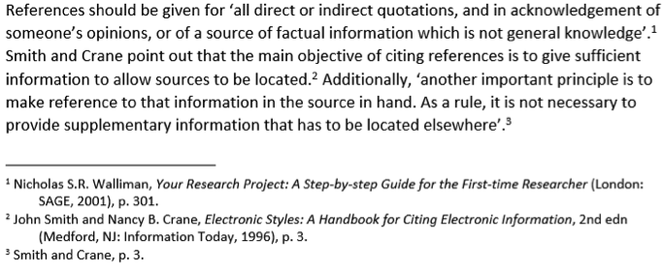
FootNotes:
Footnotes are usually sequenced: series of numbers above the text (superscript) are placed in the appropriate part of the text to indicate the cited work and are matched at the bottom of the page after the footnote.
A footnote lists the author, title and details of publication, in that order.
Advantage: To acknowledge the source of ideas, data or quotations without undue interruption to the flow of the writing

Slide 29
APA (in-text citations)
APA (American Psychological Association) is widely used and is one of the most common reference styles that students are expected to use.
Elements of APA: Citations with the text and their corresponding source details in a references list at the end of the work.
When referencing using APA, the author’s surname and the date of the publication are featured in the text. If quoting directly from the source, then the page number is also included.

Slide 30
Seeking Permission – KK4
Permission must be sought for collecting any data or information that involves people, because of privacy laws such as the Australian Privacy Principles (APPs).
Permission is usually provided in written form and is often known as consent. (Consent forms)
Participants also need to be informed about what the research entails. (Participation Information statements)

Slide 31
Consent Forms should have…
The title of the project
The name of the researcher
What the project is about and why it is being undertaken
What is required from the participants in terms of time, effort, resources and costs
The rights and interests of the participants – that they freely consent to be involved and can withdraw at any time
A statement whether the participant’s identity will be preserved
Statement of confirmation
Name of participant, signature and date

Slide 32
Participation Information statements
Provided information about the research
Language should be clear, concise, invitational, culturally appropriate and logically set out
Ask others to read and edit your document
Include a statement on how the data will be stored
State where and how the research findings will be published
Give further information about the project, such as whom to contact
Once they have read and understood the info statement, they are asked to sign the consent form to indicate their agreement to participate.

Slide 33
Privacy
When undertaking research, it is very important to uphold the privacy of the participants
To maintain privacy, and to de-identify the data, personal identifiers such as names and birthdates that are associated with individuals need to be removed so that information cannot be traced or identified

Slide 34
Physical and Software Security controls
Encryption – translating data into a secret code that can only be read by authorized users.
Backups – full backup, differential backup, incremental backup, cloud storage (can be accessed from anywhere and protect from any natural disaster)
Usernames and passwords
Firewall – server and software combination that filters the information coming through an internet connection into an organization’s internal network.
Malware protection

Slide 35
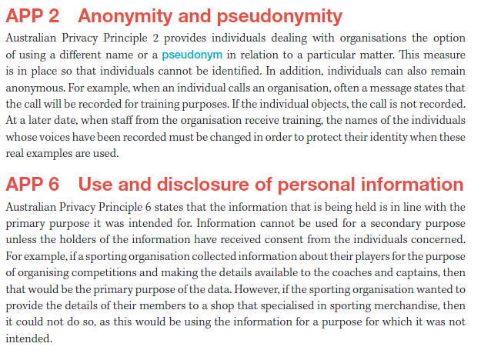

Slide 36
Ethical Dilemmas
The word “Ethics” is derived from the Greek word Ethos, meaning habit or custom.
Ethics tells us about right and wrong.
Many ethics courses begin with a discussion of the “trolley” problem. In a nutshell, the problem is this: A runaway trolley car is about to run over five innocent people; you can throw a switch to divert the trolley car to a different track where it will run over only one person; should you throw the switch? In other words, should you perform an action that kills one person to save five others? If you begin with a moral position of “It is wrong to kill,” you have to work hard to develop the exception that lets you throw the switch.

Slide 37
Ethics are rules that we all voluntarily follow because it makes the world a better place for all of us.
If we don't have ethics, we are not civilized.
So, let's look at an example.
Ethical principles stop me from stealing your wallet.
Now there are other things that could stop me from stealing your wallet.
If you're bigger and stronger, I may not want to steal your wallet because I'd be afraid that you'd beat me up.
But ethics would stop me even if you're smaller and weaker.
It's possible that I won't steal your wallet simply because I'm worried that I'll get caught, and then I'll get thrown in prison.
Ethics stops me from stealing your wallet even if there's no chance that I will be caught.
It's a fundamental principle of what we think is right.

Slide 38
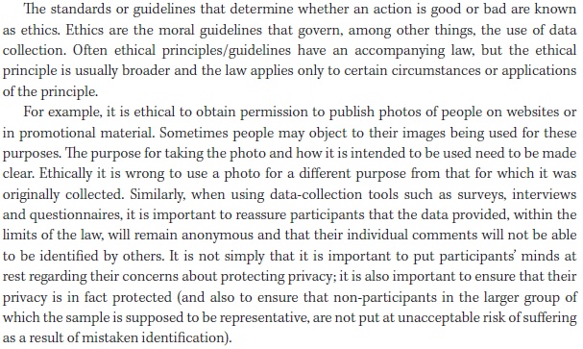

Slide 39
Chapter 2
Approaches to problem solving methodology: data analysis
Sources: https://www.slideshare.net/byronmitchell/problem-solving-methodology-15202334?from_action=save

Slide 40
Problem Solving Methodology: (PSM)
PSM
Analysis
oSolution requirements
Design
Solution design
Development
Manipulatiion (coding)
Documentation
Evaluation
Evaluation Criteria
Validation
Testing
Strategy
Report
Solution constraints
Scope of solution

Slide 41
Solution Requirements
Analysis
Determining the solution requirements.
What information does the solution have to provide?
What data is needed to produce the information?
What functions does the solution have to provide?
These requirements can classified as being
functional (namely what the solution is required to do) and
non-functional (which describes the attributes the solution should possess, such as user friendliness, reliability, portability, robustness, maintainability).
Tools to assist in determining the solution requirements include context diagrams, data flow diagrams and use cases.

Slide 42
Solution Constraints
Analysis
Identify the constraints of the solution
What conditions need to be considered when designing a solution?
Typical constraints include cost, speed of processing, requirements of users, legal requirements, security, compatibility, level of expertise, capacity, availability of equipment

Slide 43
Scope of Solution
Analysis
Determining the scope of the solution.
What can the solution do?
What can’t the solution do?
What are the benefits of the solution to the user?
The scope states the boundaries or parameters of the solution. Benefits can be stated in terms of their efficiency and effectiveness.

Slide 45
Solution design
Design
Planning how the solution will function, and the appearance of the resulting information. The solution design typically involves identifying what specific data is required and how the data will be named, structured, validated and manipulated.
Typical design tools for this purpose include:
Data dictionaries and data structure
Diagrams, input-process-output (IPO) charts
Flowcharts
Pseudocode
Object descriptions

Slide 46
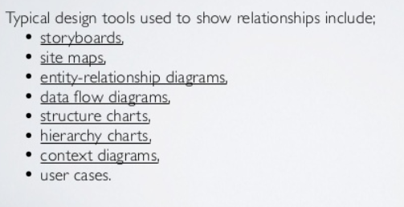

Slide 48
Evaluation Criteria
Design
Determining the evaluation criteria
What measures will be used to judge whether or not the solution requirements have been met?
These criterial should relate to the solution requirements identified in the analysis stage

Slide 49
Manipulation (coding)
Development
Determining the evaluation criteria

Slide 50
Validation
Development

Slide 51
Testing
Development

Slide 52
Testing
Development

Slide 53
Strategy
Evaluation

Slide 54
Report
Evaluation

Slide 55
Chapter 2: Data and Graphic Solutions
Analysis stage

Slide 56
Analysing the problem
First stage of PSM
Most Crucial stage – getting the analysis stage correct and having a clear picture of what is required will provide you with the appropriate building blocks for the latter stages
Example:
CASE STUDY- Hypothesis: The number of students undertaking STEM subjects is insufficient for Australia’s future needs (Based on PISA(every 3 years for 15 year olds) and TIMSS results(for grades 4-8) – international assessments)
Testing Hypothesis: To test out the hypothesis, an investigation of year 11 and 12 students and their STEM choices can be undertaken at the college.

Slide 57
Think-Pair-Share
In Pairs,
Discuss about different problems for investigation and come up with a list of at least three topics for your case study that you can use for your SAC
Some suggestions:
Canteen menu – looking into current menu and proposing a better one
Team(Pastoral Care) activities – how the time in team can be better used
Lateness to school – What is the major reason

Slide 58
Designing solutions
Second stage of PSM
Designing a solution often occurs without using a computer at all – the solution may just be drafted on paper, advantage being you can sketch your ideas quickly and easily and you can make changes easily without affecting the development of a solution.

Slide 59
Designing solutions – CASE STUDY

Slide 60
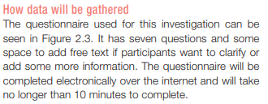
Designing solutions – CASE STUDY
Questions for the questionnaire:
Please select your year level (11 or 12)
Are you currently studying STEM subjects?
Which of the following STEM subject are you currently studying?
How important is each factor to your success in STEM?
Who had the greatest impact on your decision to pursue STEM subjects?
Are you hoping to pursue a STEM career post secondary collge?
What are your reasons for pursuing a STEM career?

Slide 61
Designing solutions – CASE STUDY
Figure 2.4 p.37

Slide 62
Design Tools – KK10 pp.66-68

Slide 63
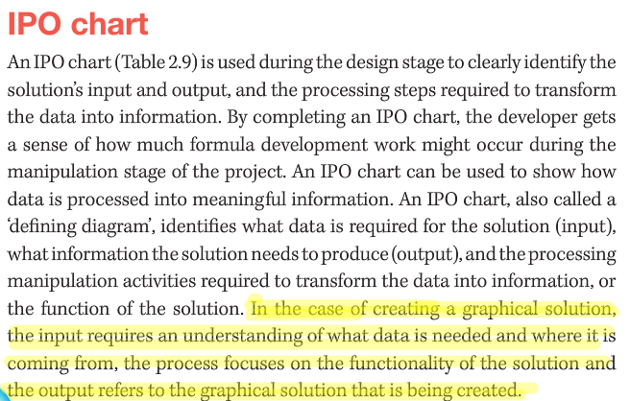
Design Tools – KK10 pp.66-68 Design Tool for functionality – IPO Chart

Slide 64
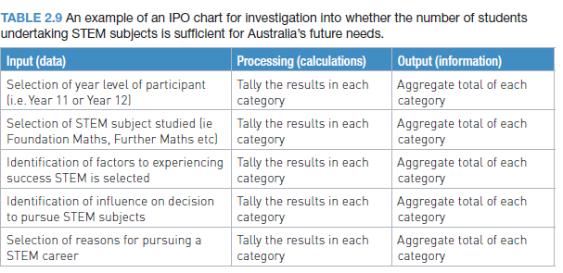
Design Tool for functionality – IPO Chart

Slide 65
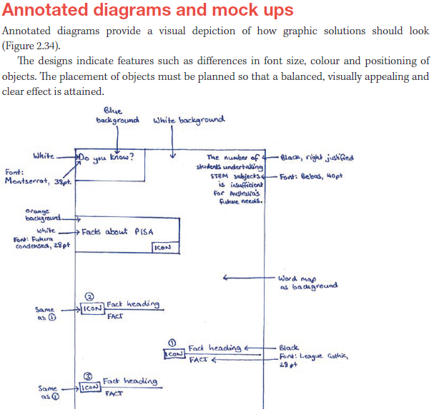
Design Tool for appearance – Annotated diagrams

Slide 66
Graphic Solutions – Why “Graphic”?
A graphic solution visually represents analysed data.
Purpose of Graphic Solutions:
Makes reading data and information more interesting, less time-consuming and more understandable
Allows data to be compared at a glance.
Provides greater clarity and assists in identifying trends and patterns in our data
it is an elegant way to represent complex information or large amounts of data (through the use of different types of charts for different purposes – bar chart, histogram, scatter diagram, animation or simulation)

Slide 67
Purposes of your Graphics solution– Appropriate graphic solution will need to be selected based on how the data will be used to persuade, inform or educate
Purpose | Explanation | Example
Inform | Providing information or tell facts, such as reporting on a current issue | Data obtained about the number of elderly pedestrians injured crossing a major intersection can inform the local government about the black spot
Persuade | Influencing a decision or action, or change a person’s opinion | Same data can be visually represented in another way to persuade the engineering department of the local government to make adjustments to the intersection to prevent further injuries
Educate | To teach and provide knowledge and skills through a learning process | The data can also be used to educate the elderly about the need to be vigilant when crossing the intersection

Slide 68
https://www.ted.com/talks/david_mccandless_the_beauty_of_data_visualization

Slide 69
Types of Graphic Solutions
Charts
Flowcharts
Diagrams
Images
Hierarchies
Animations
Maps
Timelines
Infographics

Slide 70
Types of Graphic Solutions – CHARTS/GRAPHS
Most common form of charts are column graphs, bar graphs and line graphs
They generally use a scale or a series of data sets that are indicated along two axes. However, in the case of pie graphs, they use the divisions of the whole to communicate the quantities of data.
Charts may be 2D or 3D
Column and bar graphs are handy for presenting data changes over a period of time or for showing comparisons across different times. The differences can be recognized quickly
Line graphs are used to display continuous data over time. It is useful for showing trends in data at equal intervals.
Consider a pie graph if you need to depict approximate proportional relationships. The full circle represents 100%
Rules with charts (Refer to p.44 in the textbook)

Slide 71
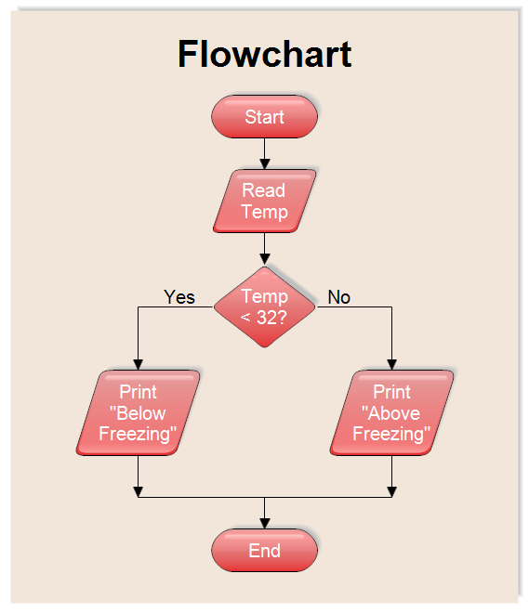
Types of Graphic Solutions – FLOWCHARTS
Flow charts represent the steps in a process or system
They are used much in information systems
because they help explain very complex,
technical processes.

Slide 72
Types of Graphic Solutions – DIAGRAMS
Diagrams present data or information in a visually clear, accessible way using formats and conventions such as colours, symbols, points, lines, shapes and explanatory drawings.
Common types of diagrams include blueprints, schematics and annotated diagrams.

Slide 73
Types of Graphic Solutions – IMAGES
Images may include illustrations and photos.
May be drawn by hand using techniques such as orthographic, isometric or perspective or using software such as Adobe Illustrator.
May also be art, cartoons and caricatures, with varying levels of detail.
What makes them different from other types of graphic representations in this context is that they usually are not representing data

Slide 74
Types of Graphic Solutions – HIERARCHIES
Hierarchies are a type of chart that usually depict the relationships and hierarchy between roles in an organization, institution, project team, site map or process chart. Family trees are another type of hierarchy.

Slide 75
Types of Graphic Solutions – ANIMATIONS
You could use an animation to show the workings of part of a solution or to instruct on the functionality of your design. Animation may be used when printing is not suitable to communicate your message.

Slide 76
Types of Graphic Solutions – MAPS
Maps such as road maps, cities and transport maps can create effective directional design when signage and other wayfinding devices applied ot them. Adding symbols and other conventions, such as arrows, lines and text to a map conveys a great deal more information.

Slide 77
Types of Graphic Solutions – TIMELINES
Timelines show events, images or data in chronological order. A timeline may include both images and text.
They are often used in infographics to show comparisons or changes over time.

Slide 78
Types of Graphic Solutions – INFOGRAPHICS
An infographic includes
Graphs
Pictures
Diagrams
Narrative
Timelines
Infographics often communicate multiple findings for a topic. An infographic is more than building a chart in a spreadsheet. Think of it as a creative poster that uses illustrations, icons, graphics and different fonts and colours to make a point.

Slide 79
Types of Graphic Solutions – INFOGRAPHICS
The steps to create an infographic are :
Conduct an investigation into an issue, practice or event
Interpret the primary data
Familiarise yourself with different ways to visualize data
Mock up a design of the infographic
Create the infographic
Include references/citations/sources in the infographic
Apply formats and convention to the infographic
Test and validate the infographic.

Slide 80
DESIGN PRINCIPLES FOR GRAPHIC SOLUTIONS
Design principles are guidelines to help you enhance the appearance and functionality of solutions. Graphic solutions that are displayed onscreen need to be easily understood and accessed with minimal time and effort.
To communicate effectively, graphic solutions need to be clear and functional. You need to ensure that facts are obvious and your message is unmistakable. Your solution must be carefully designed, taking the design principles into account.

Slide 81
KK10- DESIGN PRINCIPLES FOR GRAPHIC SOLUTIONS

Slide 82
DESIGN PRINCIPLES – FUNCTIONALITY
Functionality Characteristics | Explanation
Usability | All graphic solutions need to be easy to use, flexible and robust. When designing infographic for usability, consideration should be given that the user quickly identifies the purpose of the graphic form and interpret its critical data. it is accurate and a true reflection of the data that has been analysed it is in a size that will be quick to load and works in multiple browsers Works well when printed in both colour and greyscale
Accessibility | A user should be able to access meaning and relevant information from a graphic solution efficiently and easily. Users should not have to puzzle over the meaning or placement of text and symbols used. Use simple and relevant labels such as $ to represent money. Users should be able to navigate their way through text and images from top to bottom or left to right. Use arrows if you literally want their eyes to move a certain direction.

Slide 83
DESIGN PRINCIPLES – APPEARANCE
Appearance Characteristics | Explanation
Alignment | Similar to using Word-processing software, this involves aligning text and images to the left, right, centre or full justified. Using alignment gives the text, images and objects a sense of order and organization that helps to communicate your message clearly. When planning for your solution, manage the elements of your infographic by drawing a visual ‘grid’. This will help you to work out where you can place items, how much space you have and what kind of alignment works best for each element
Repetition | This refers to the use of same or similar visual elements repeatedly within a graphic solution. (repeated pattern, textures, fonts, colours and page elements).
Contrast | This refers to the visual difference in colour or tone between objects. Greater contrast will make objects appear to stand out more from one another.
Space | This refers to the areas around and between objects – text and images. If your graphic solution is cluttered it may be difficult to follow.
Balance | A balanced solution creates visual appeal. For example, you see the same amount of white space on the left side as on the right.

Slide 84
KK11 – Useful Formats and Conventions
CONVENTIONS:
A convention is a formal and accepted way of displaying information, like the layout of a letter.
The major aim of conventions is to ensure that information is displayed in a consistent fashion
For example, the ‘FROM’ address on an application letter is right aligned
FORMATS:
A format is a customised change to the appearance of a convention, for example the use of different fonts and sizes in letters from different organisations.

Slide 85
KK11 – Useful Formats and Conventions

Slide 86
KK11 – Useful Formats and Conventions
Formats/Conventions | Description
Titles | Generally styled as Headings, with type that is bold and larger than the body text or subheadings. Should be concise, to-the-point and easy to say. (Fig. 2.24)
Text styles (Fonts) | Keep things simple when choosing text styles. Use perhaps three at most and use bold, italic, colour and point size to set out heading levels and distinguish between different types of text. (Fig. 2.25) Rememeber: Less is still more – bigger is not always better
Shapes | Using shapes can help to create patterns, contrast, hierarchies, backgrounds or even logos. Shapes can also be non-standard ones such as irregular, abstract and freeform shapes. (Fig. 2.26)
Lines and arrows | Lines can be used as borders or containers for sections of text or images. It can be solid, dashed, dotted, broken, double, thick, thin etc. Do not use too thick lines as the solution will look more crowded. When using arrows, colour of the lines, arrows and choice of arrowhead can make a difference in the appearance.(Fig. 2.27/2.28)
Sources of data and legend | Identify the source of your data in an appropriate way. List all the sources in the footer of the infographic. Include the name of the source, the author, the URL, the page number, the date, the publisher and any other relevant information. Include legends (keys that explains the symbols used in a chart, diagram, map or table). Design them to take up very little space. (Fig. 2.29)
Colours and contrasts | Use right colours that make the information clear, readable and attractive. Avoid using red and green together, blue and brown together because they can be different to read by colourblind people. (Look at pp.64-65 for psychology of colours)

Slide 87
KK12 – Softwares and Techniques for Developing graphic solutions
This is the stage at which the data (numbers, text and audio data from interviews) becomes information. Manipulation occurs when the data is transformed into information.
The nature of manipulation usually depends on the software being used to create the infographic.
Infographics generators:
Offline | Online
Combination of Excel and Powerpoint | Infogram, Piktochart, Venngage, Canva, and Easel.ly

Slide 88
KK13 – Techniques for testing graphic solutions
Testing is important to check that what you are trying to produce meets the specified need and purpose. The effectiveness of a solution is determined by its quality. A solution is effective if it is complete, readable, attractive, clear, accurate, accessible, timely, relevant, usable and if it communicates the message. Each of these attributes needs to be tested once the solution has been built.

Slide 89
KK13 – Techniques for testing graphic solutions
Testing
Completeness Testing | To check the completeness, you should consider the following: Does the solution provide the information required? Is the solution clearly and accurately labelled? Will the intended users easily find what they need?
Reliability Testing | To determine the reliability of data, the reliability of the source should be checked. One way the information in a solution can be verified is to confirm the information from more than one source. Unreliable graphic solutions can cause confusion.
Presentation Testing | During the design phase of PSM, decision must be made on the appropriate format of the solution (using annotated diagram). Adhere to formats and conventions discussed earlier.
Functionality Testing | Test that the representation accurately depicts the data as it was meant to. Develop a test plan in the format of a table (Table 2.10 p.69), which is a method for recording the tests to be executed and the results of the tests. Complete your test table while developing your solution, using any mistakes you make as a basis for good testing.
Relevance | A question to consider in checking the relevance of a solution is: “Does the infographic match the user’s search for information?”
Communication of message | All information presented should be clear and obvious, without getting lost among other insignificant or relevant information
Overall testing | Refer to page 70 for more questions to ask

Slide 90
Validation Vs Testing
Validation | Testing
Validation is involved with input Validation checks that input data is appropriate and reasonable | Testing is concerned with the solution itself Testing is performed to ensure that processes, functions and formulas in a solution work as expected

Slide 91
Validation
Although validation is actually used when entering data during the development stage, it needs to be planned for in the design stage.
It is easy for data entry errors to occur during the input phase, particularly if a large amount of data is involved. Data should therefore always be validated before any processing occurs.
Two types of Validation:
Manual Validation: Data entered are checked for accuracy by a person rather than by a machine. Proofreading is one manual validation technique. The data entered should be compared with the source document to ensure that they match. Any differences should be followed up.
Electronic Validation: Data is validated by a computer using the built in validation function contained in the software (as in Excel). Types of electronic validation include range checking, existence checking and data type checking.

